Slide 1
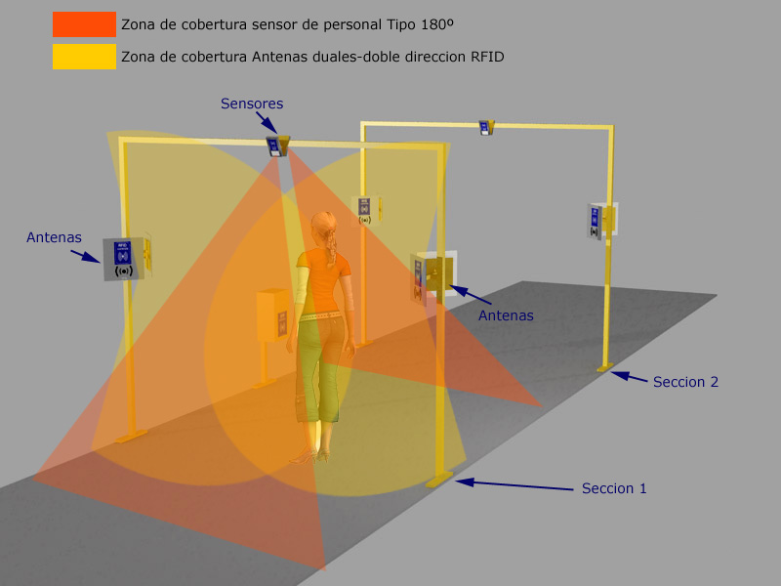
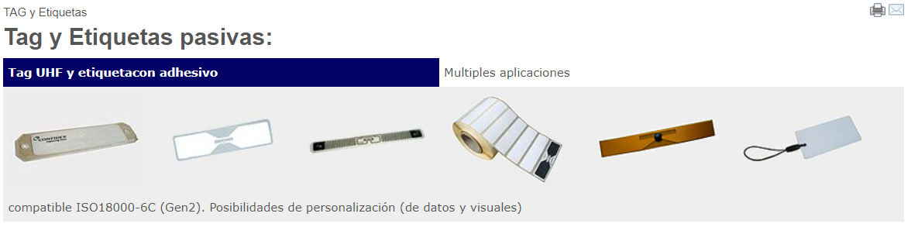
https://www.rfidcontrols.com/rfidcontrols/index.php/sample-sites/accesos.html

Slide 2
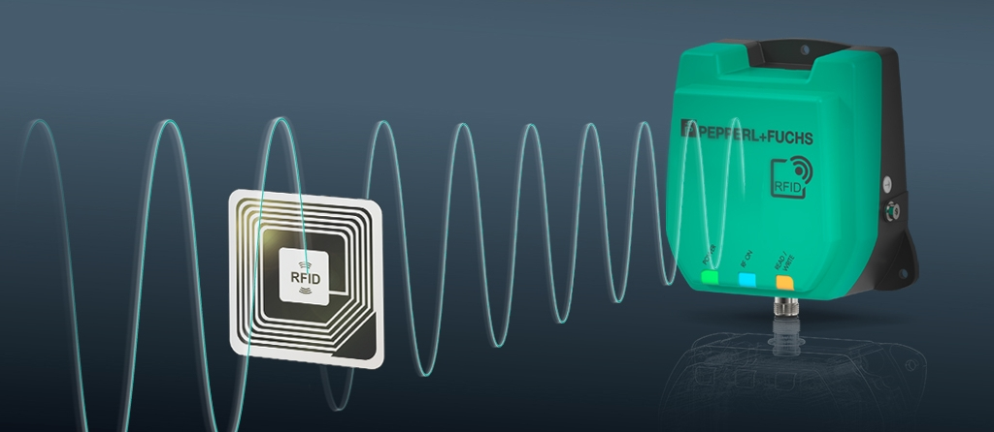
https://www.pepperl-fuchs.com/spain/es/RFID-Hub.htm
https://blog.pepperl-fuchs.com/en/2016/ten-application-examples-for-rfid-in-industrial-automation/?utm_source=mlp-spain&utm_campaign=mlp-rfid-hub&utm_term=learn_more&utm_medium=www
2. What Is the Difference between Active and Passive RFID Tags?
Another distinction that you will most likely stumble upon when dealing with RFID is active versus passive RFID tags. Active RFID tags feature a transmitter and their own integrated power source. This source powers the application-specific integrated circuit of the tag and is also used to transmit a signal from the tag’s antenna to an RFID reading device.
Passive RFID tags have no integrated battery or power source. Instead, they draw power from an RFID reader that sends out electromagnetic waves. These waves induce a current in the tag’s antenna and enable mutual communication between reader and tag. Additionally, there are semi-passive RFID tags available on the market. These semi-passive tags use a battery to run the integrated circuit of the tag, while the actual communication happens by drawing power from the RFID reader.
When it comes to tracking high-value goods over long distances, active and semi-passive tags are an excellent choice. For mass tracking of low-cost items over smaller distances, passive RFID tags are the right solution, as they are significantly less expensive than active and semi-passive tags. Active RFID tags with batteries and long-range antennas tend to be bigger than passive tags. Depending on the RFID reader’s performance, they can achieve read ranges of up to 300 meters. Smaller low-frequency and high-frequency RFID tags are read from within 0.5 meter distance, and UHF tags are mostly read from 3 meters to 6 meters distance.
https://blog.pepperl-fuchs.com/en/2016/frequently-asked-questions-faq-on-rfid-part-4-rfid-tags/?utm_source=mlp-spain&utm_campaign=mlp-rfid-hub&utm_term=learn_more&utm_medium=www

Slide 3
Uso en competiciones deportivas para medir tiempos o pasos por balizas intemerdias
https://www.sicomtesting.com/es/blog/tecnologia-rfid-controllo-accessi/

Slide 4
VENTAJAS
Control de entradas y salidas en tiempo real. Control aforo/asistencia
Menos intrusivo que una cámara TV
INCONVENIENTES
Se debe llevar encima la etiqueta RDFI
Envío de mensajes/Alertas basado en eventos (cruce puerta o tiempo permanencia)
Seguridad: Detectar salidas del recinto fuera de horas permitidas
Seguridad: Detectar permanencia excesiva en dependencias (aseos)

Slide 5
Dirigido a:
Centros escolares
Centros personas mayores
Conciertos
Eventos en recintos
Ferias
Parques acuáticos
Parques de atracciones
Piscinas comunidades

